Slide 1
CogniDispatch
AI-Powered Emergency Home Service Triage
Enterprise-Grade Microservices & Secure Azure Kubernetes Infrastructure
Cloud Architecture Series · 2026

Slide 2
What is CogniDispatch?
Input Channels
Matching Engine
Execution
Voice-Activated AI Triage
Speech-to-text with emergency classification
Vision Damage Scan
Photo analysis with hazard detection and severity scoring
Real-Time GPS Telemetry
Connects closest qualified technicians via WebSockets for live tracking
Smart Dispatch
Matches emergency type to certified technician skill sets
Secure Handoff OTP
4-digit code verified on arrival prevents fraud
Payout Checkout
80% technician payout, 20% platform commission
02

Slide 3
End-to-End Workflow Architecture
Next.js Client
Auth Service
AI Service
Vendor Service
Dispatch
Data Layer
Port 3000
Homeowner, Tech & Admin UIs
Port 5001
Identity & RBAC
Port 5003
OpenAI & Speech APIs
Port 5002
Technician Profiles
Port 5005
WebSocket.IO
Cosmos DB
MongoDB API
Shared MongoDB adapter ensures transaction consistency across all microservices
Admin Service (Port 5004) — Dashboard metrics, statistics, and platform controls
03

Slide 4
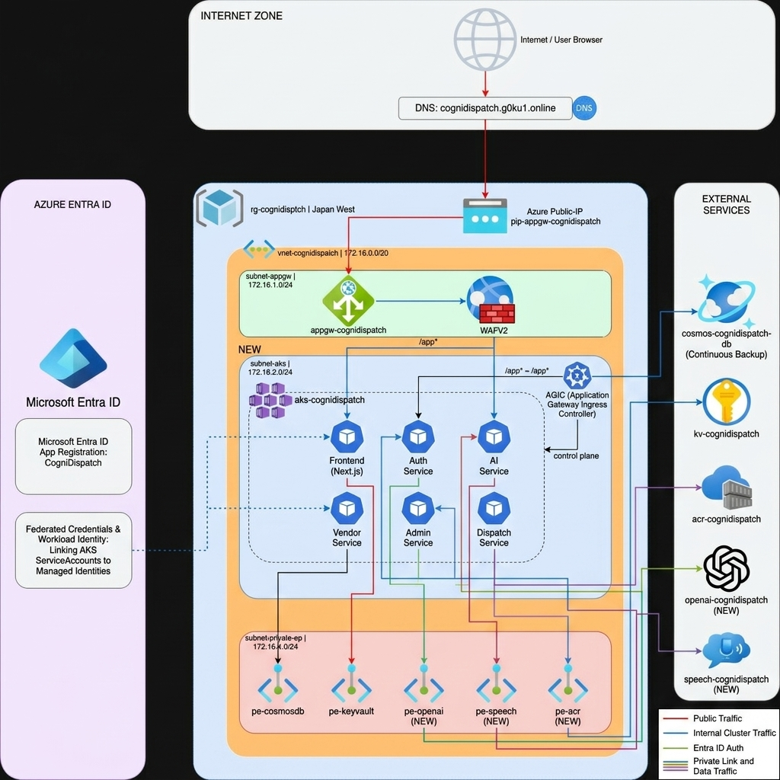

Slide 5
Zero-Trust Network Topology
Hub-and-Spoke VNet with Network Security Groups (NSGs) guarding all access boundaries
AKS Subnet (snet-aks)
App Gateway (snet-appgw)
Hosts the private Azure Kubernetes Service cluster. All container workloads run within this isolated subnet.
Houses the internet-facing ingress load balancer. Entry point for all external traffic into the cluster.
Private Endpoint (snet-pe)
Bastion (snet-bastion)
Dedicated for secure internal connections to platform resources. Private Link for all Azure services.
Azure Bastion Host and management jumpbox VM for secure administrative SSH access.
04

Slide 6
Routing Ingress via AGIC
Application Gateway Ingress Controller replaces traditional Nginx with Azure's native Application Gateway
App Gateway
Path-Based Rules
AKS Pods
Azure Application Gateway receives traffic on ports 80/443
Routes by URL path to appropriate backend services
Dynamic routing to containerized workloads
Path-Based Routing Rules
/
Next.js Frontend (Port 3000)
Helm Templating
Conditional values block maps azure-application-gateway class for dynamic AGIC path configuration
/api/
Backend Microservices (Port 5000)
/socket.io/
Dispatch WebSocket (WS upgrade)
05

Slide 7
Cosmos DB & Azure Key Vault
Azure Key Vault
CSI Secrets Store
cognidispatch-kv
SecretProviderClass maps Key Vault secrets directly to Kubernetes pods as inline volume mounts
No environment variables exposed in plain text
Stored Secrets:
• MONGODB-URI
• AZURE-OPENAI-KEY
• AZURE-SPEECH-KEY
• JWT-SECRET
Cosmos DB (MongoDB API)
Enterprise-scale document database secured behind Private Endpoints (dns-zone-cosmos-id). Database access is restricted exclusively to within the VNet — no public IP exposure.
06

Slide 8
Passwordless Authentication with Workload Identity
Kubernetes OIDC
Federated Identity
RBAC Access
OIDC Issuer
AKS cluster establishes trust with Microsoft Entra ID via OIDC discovery
Token-based auth without passwords
Federated Credentials
Connects K8s ServiceAccounts to User-Assigned Managed Identities in Azure
No client secrets stored in Kubernetes
Key Vault Secrets User role assigned to Managed Identity
ServiceAccount annotated with azure.workload.identity/client-id
07

Slide 9
AI Triage & Damage Recognition Engine
Speech Input
NLP Parsing
Vision Scan
Private Link
Dispatch
Azure Speech Services generates secure temp tokens
GPT-4o extracts keywords and classifies emergencies
Vision detects severity and recommends containment
All AI traffic over Azure private backbone
Severity triggers priority dispatch
GPT-4o | NLP Classification | Severity Estimation | Safety Recommendations | Private Endpoints
08

Slide 10
Scalable Dev Pipeline & Organization
Build
Registry
Reusable Workflows
Standardized CI templates
Azure Container Registry
Premium SKU registry
Source
Security
Deploy
Multi-Repo
Independent repos for separation
Security Gates
SonarQube, Snyk & Trivy vulnerability scans
Dev Branch Policy
CI runs on dev branch, isolated from production
Organization: cognidispatch | Independent microservices repositories | Standardized GitHub Actions reusable workflows
09

Slide 11
Architecture Highlights
Zero Trust Network
Passwordless Security
Scalable Microservices
Every database, AI endpoint, and registry uses private link endpoints
Managed identities and OIDC credentials replace static passwords
Each service scales independently
CogniDispatch — Enterprise-Grade AI-Powered Emergency Response
Azure Kubernetes Service · Azure OpenAI · Cosmos DB

